Slide 1
Sales Strategy Pens and printers

Slide 2
Overview
Customers per approach – Email, Call, Email + Call
Spread of revenue
Spread for each method
Difference in revenue over time
Method Recommendation
Other differences between customers?

Slide 3
Investigating the data
15,000 unique customers 15,000 total customers
Sales approaches / methods Email, Email + Call, Call, em + call, email
Missing data 7.16% of data is missing revenue - impute
Customer Spread Email: 6922 / Call: 4781 / Email + Call: 2223

Slide 4
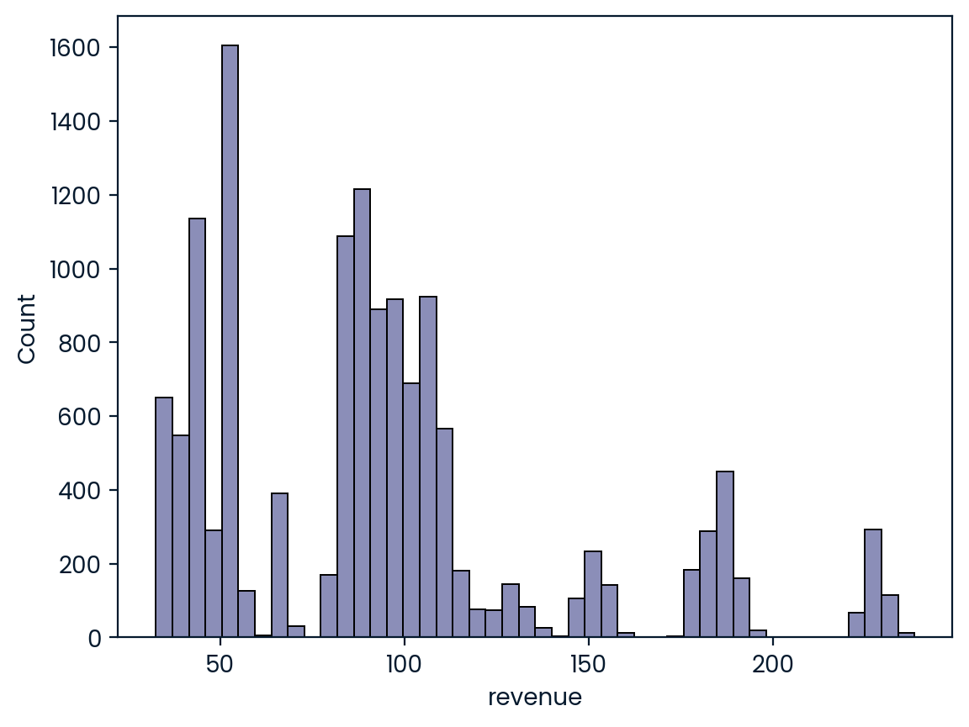
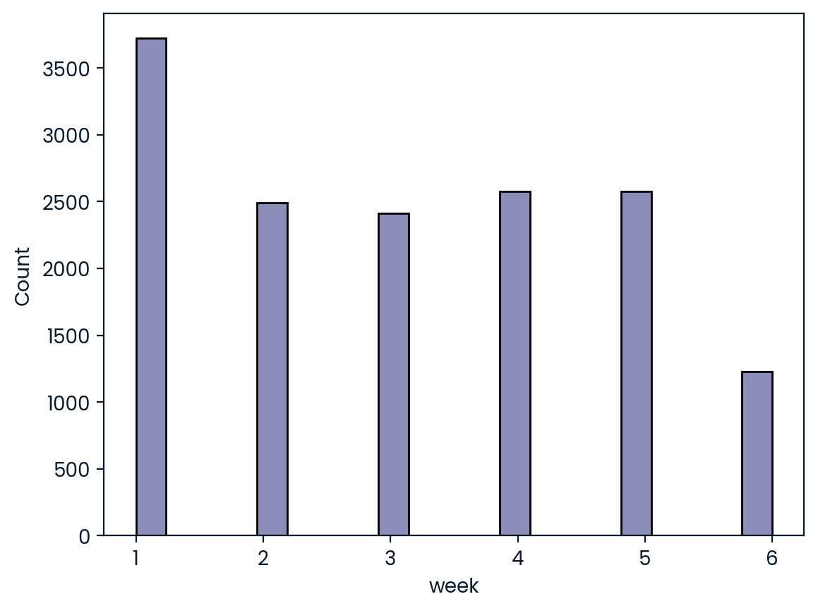
Revenue Spread

Slide 5
Metrics
Predictor | Correlation | P-value
Sales Method: Email + Call | .837 | 0.0
Number of product sold | .691 | 0.0
Week | .358 | 0.0
--- | --- | ---
Sales Method: Email | 0.030 | 2.6e-15

Slide 6
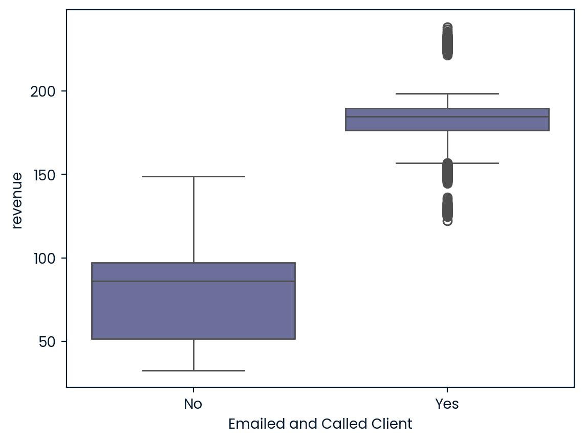
Email + Call effectiveness

Slide 7
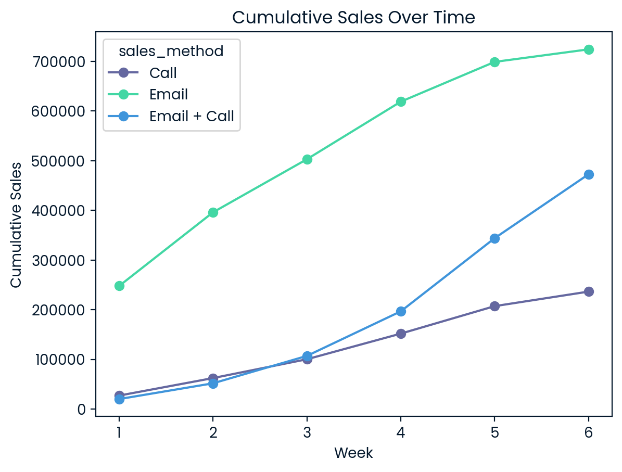

Slide 8
Revenue Per Customer
Sales Method | Total Rev | Revenue / Customer
Call | $236,445 | $47.65
Email | $724,313 | $97.01
Email + Call | $472,731 | $183.80

Slide 9
Recommendations
Email: Continue to send an initial email!
Call: Stop making cold calls (30 min avg)
Email + Call: Focus time and effort here! (10 min avg)
Strong correlation coefficient of 0.8
One-way ANOVA test confirmed they spend more on average

Slide 10
THANK YOU

